Slide 1
Bar codes
PRESENTING BY : ZAIN HAIDER NAQVI

Slide 2
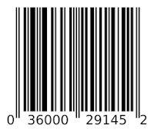
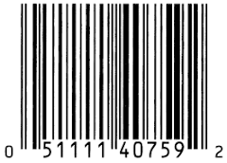
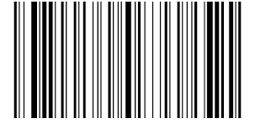
What are bar codes ? How they look like ?
A Barcode or bar code is a method of representing data in a visual, machine-readable form.

Slide 3

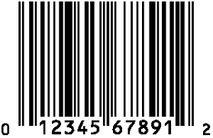
Barcodes: Types of BarCodes
There are many types of barcodes and each brings unique opportunities and limitations.
Barcodes are available in two different types: Linear barcodes and two-dimensional matrix barcodes.

Slide 4
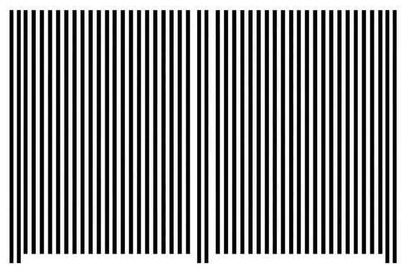
How to decode the 1d bar codes ! Simple bar code look like !!!

Slide 5

They have 95 black and white lines !!!

Slide 6
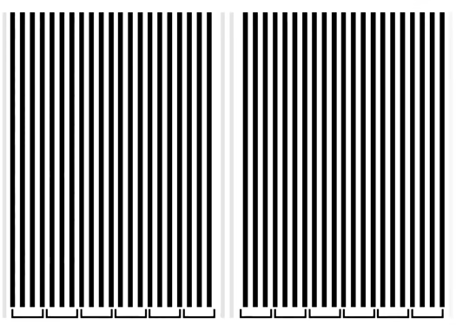
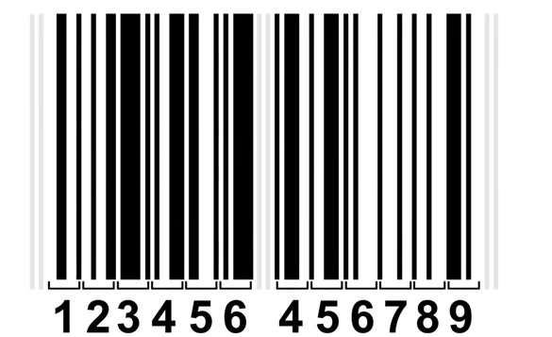
If we Group it with 7 lines we have !!!

Slide 7

Comparing left side lines to right side lines

Slide 8


Slide 9


Slide 10


Slide 11


Slide 12



Slide 13


Slide 14
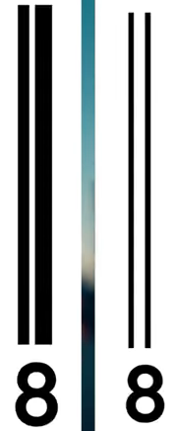

Slide 15


Slide 16
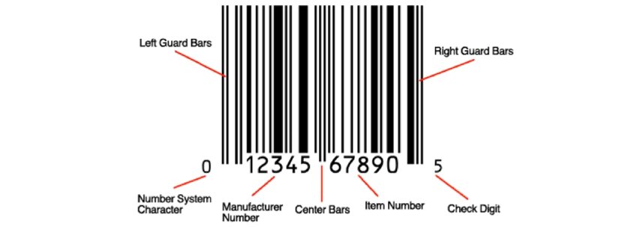

Slide 17
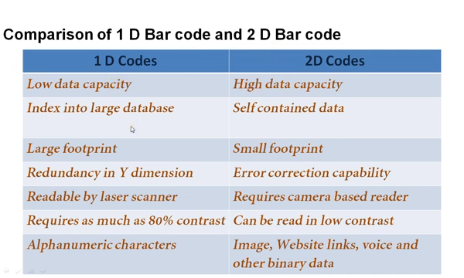

Slide 18
1d bar codes and there types
Linear barcodes

Slide 19
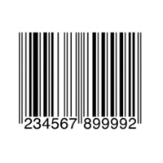
Linear barcodes. These consist of lines and spaces of various widths that generate specific patterns. ..
1 :UPC CODE
Industry: Retail
Variations: UPC-A, UPC-E
UPC actually stands for universal product code :::::::::::: The purpose of this barcode is to make it easy for users to identify specific product features such as the brand name, item, size, and color, when an item is scanned at checkout.

Slide 20
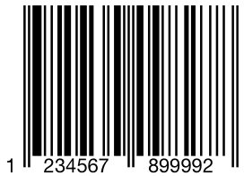
Linear barcodes. These consist of lines and spaces of various widths that generate specific patterns. ..
2: EAN CODE
Industry: Retail
Variations: EAN-13, EAN-8, JAN-13, ISBN, ISSN
They look very similar to UPC codes, and the main distinction is their geographical application.
EAN-13 (comprising 13 digits) is the default form factor,
EAN-8 (covering eight digits) barcodes on products where space is limited, like small candies.
The main advantage of EAN codes is their flexibility.
. EAN codes are also easy for 1D scanners to read, making the scanning process fast and seamless.

Slide 21
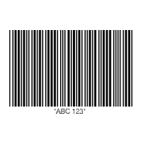
Linear barcodes. These consist of lines and spaces of various widths that generate specific patterns. ..
3: CODE 39
Industry: Automotive and Defense
Code39 barcodes (or Code 3 of 9) are used to label goods across many industries and are often found in the automotive industry
One limitation of Code39 is its relatively low data density.

Slide 22
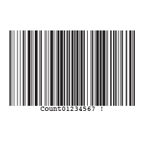
Linear barcodes. These consist of lines and spaces of various widths that generate specific patterns. ..
4:CODE 128
Industry: Supply Chain
Code 128 barcodes are compact, high-density codes used in logistics and transportation industries for ordering and distribution. They’re geared toward non-POS products, like when supply chain applications label units with serial shipping container codes (SSCC). Because they support any character of the ASCII 128 character set, Code 128 barcodes can store highly diversified information.
The greatest advantage of Code 128 is its high data density.
These strengths make Code 128 barcodes a natural choice for shipping and supply chain operations.

Slide 23
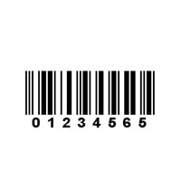
Linear barcodes. These consist of lines and spaces of various widths that generate specific patterns. ..
5:ITF (Interleaved 2 OF 5)
Industry: Packaging
ITF (or Interleaved 2 of 5) barcodes are used to label packaging materials across the globe.
ITF barcodes encode 14 numeric digits and use the full ASCII set.

Slide 24
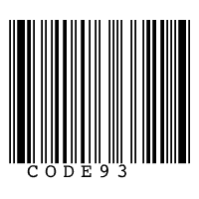
Linear barcodes. These consist of lines and spaces of various widths that generate specific patterns. ..
6:CODE 93
Industry: Retail, Manufacturing and Logistics
Code 93 barcodes are used in logistics to identify packages in retail inventory, label electronic components, and even provide supplementary delivery information for the Canadian Post

Slide 25
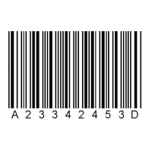
Linear barcodes. These consist of lines and spaces of various widths that generate specific patterns. ..
7:CODABAR
Codabar barcodes are used by logistics and healthcare professionals,
Variations: Codabar, Ames Code, NW-7, Monarch, Code 2 of 7, Rationalized Codabar, ANSI/AIM BC3-1995, USD-4
Industry: Logistics, Healthcare and Education

Slide 26
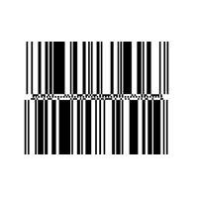
Linear barcodes. These consist of lines and spaces of various widths that generate specific patterns. ..
8:GS1 DATABAR
Industry: Retail and Healthcare
barcodes (formerly known as Reduced Space Symbology)
These codes also support faster and more efficient scanning workflows in patient care environments.

Slide 27
2d bar codes and there types
, Matrix barcodes are a two-dimensional way of representing data.

Slide 28
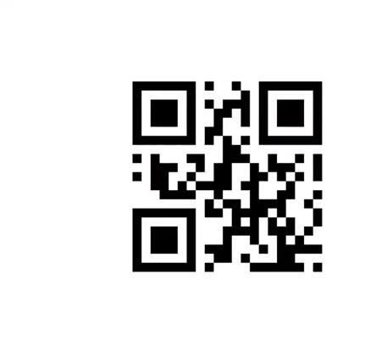

Slide 29
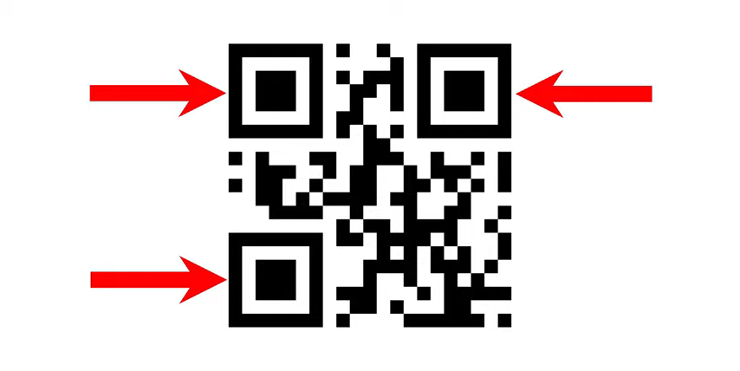


Slide 30

Scanner checkes the size of the qr code by this purple blocks

Slide 31
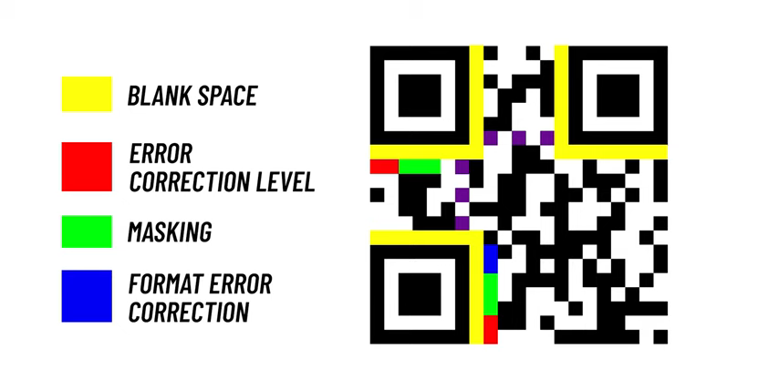

Slide 32
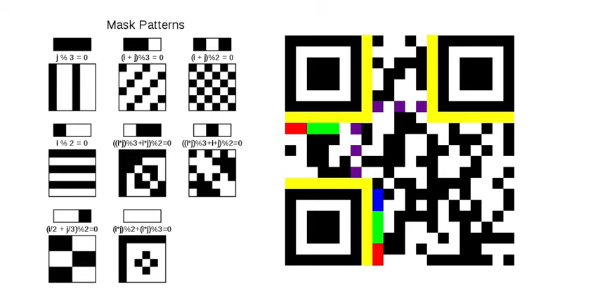
Pattern

Slide 33
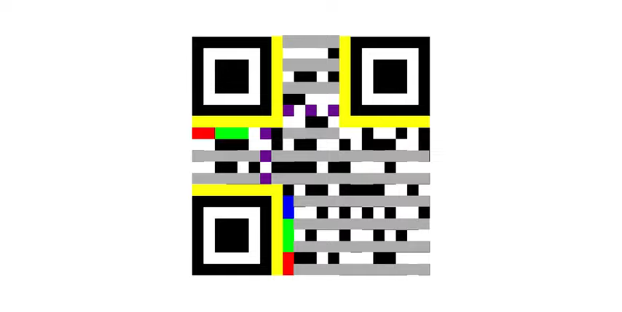
By Mixing all the alternate lines we have !!!

Slide 34
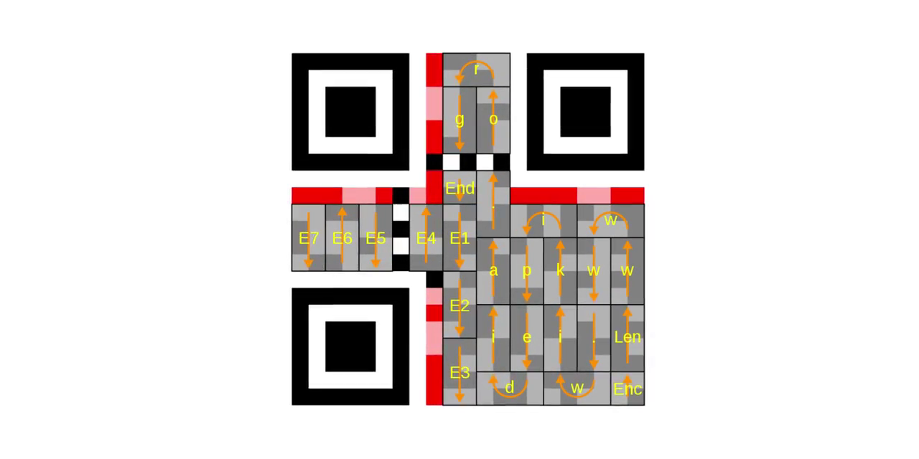

Slide 35
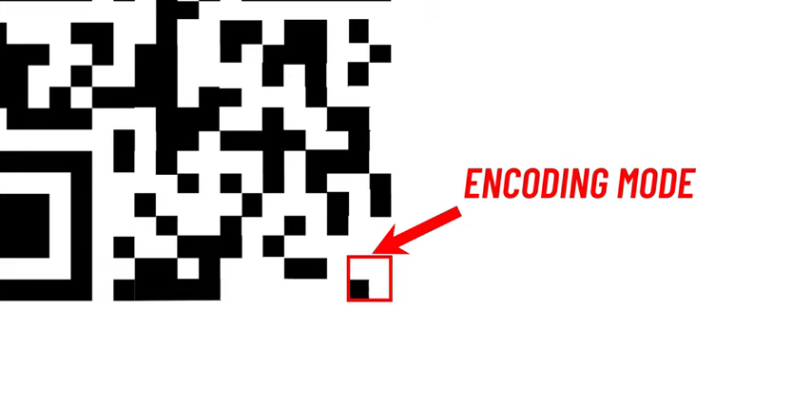
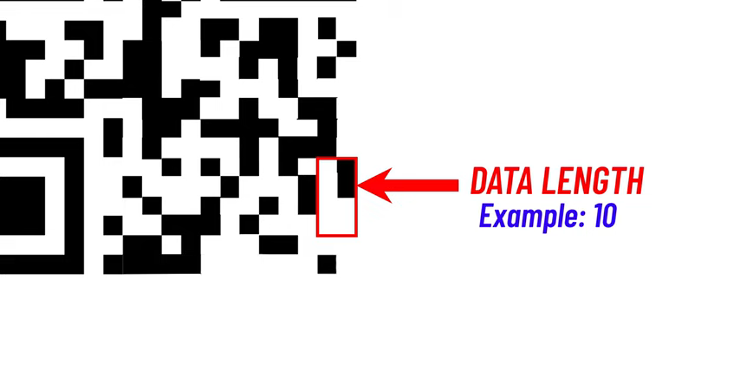
Decodind Qr code start from!!!
Which is 8 bit and 8 bit = 1 Character

Slide 36
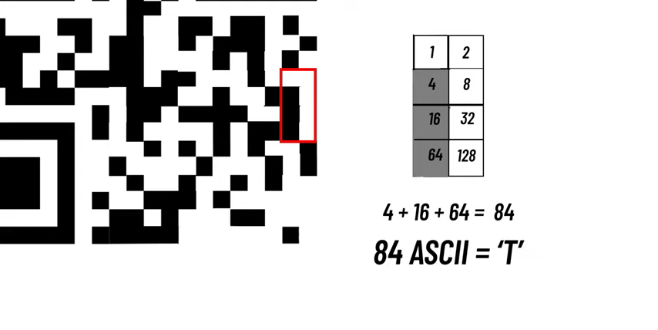

Slide 37
1:QR CODE
Industry: Retail, Entertainment and Advertising
QR codes are most often used in tracking and marketing initiatives, such as advertisements, magazines and business cards. They are flexible in size,

Slide 38
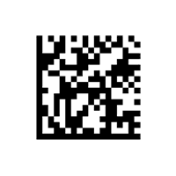
2:DATAMATRIX CODE
Variation: Micro-Datamatrix
Industry: Electronics, Retail and Government
Datamatrix codes are usually used to label small items, goods and documents. Their tiny footprint makes them ideal for small products in logistics and operations.Datamatrix codes offer high data density, which means they take up less space on products and assets. Datamatrix codes offer strong fault tolerance as well.

Slide 39
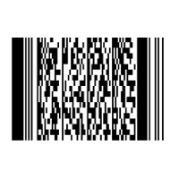
3:PDF417
Variation: Truncated PDF417 Industry: Logistics and Government
PDF417 codes are used for applications that require the storage of huge amounts of data, such as photographs, fingerprints and signatures. They can hold over 1.1 kilobytes

Slide 40

4:AZTEC
Industry: Transportation
Aztec codes are commonly used by the transportation industry, particularly for tickets and airline boarding passes.

Slide 41
Thank YOU

